Slide 1
Yr 12 atar biology
Ms Rayner 2022

Slide 2
Syllabus links
Homeostasis is the process by which the body maintains a relatively constant internal environment; it involves a stimulus-response model in which change in external or internal environmental conditions is detected and appropriate responses occur via negative feedback
Conduct investigations, including using models of homeostasis, safely, competently and methodically for valid and reliable collection of data
Changes in an organism’s metabolic activity, in addition to structural features and changes in physiological processes and behaviour, enable the organism to maintain its internal environment within tolerance limits (temperature, nitrogenous waste, water, salts, and gases)

Slide 3
Key terminology
Term | Definition
Metabolism
Enzymes
Homeostasis
Tolerance limit
Biochemical pathway
Stimulus-response model
Effectors
Stimuli
receptors
Negative Feedback
Positive Feedback
Stimulus
Receptor
Modulator
Effector
Response

Slide 4
Homeostasis

Slide 5
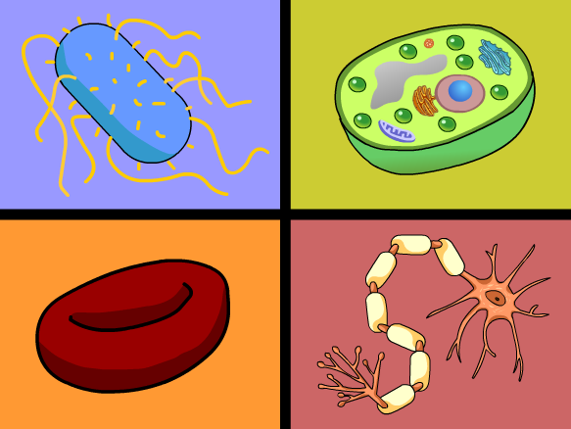
Recap:
What can you remember about the following from YR 11
Requirements for life
metabolism
enzymes

Slide 6
metabolism
Metabolism – The sum total of chemical reactions in biochemical pathways that occur within an organism to maintain life
Biochemical pathway – A linked series of chemical reactions in living organisms
Require enzymes which are – Reusable, biological catalysts (proteins) that lower the activation energy of a chemical reaction, enabling it to proceed faster
Enzymes function optimally within tolerance limits

Slide 7
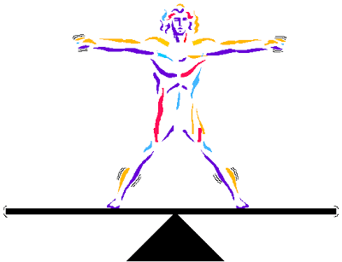
Topic Question 1: Define the term homeostasis
Each organism has a range in which they tolerate different levels of organic and inorganic materials, pressure and temperature
Homeostasis is the processes involved in maintaining a constant internal environment, within tolerance limits despite changes in the internal and external environment

Slide 8
Topic Question 2: Define the terms tolerance limit & tolerance range
Each organism has a range in which they tolerate different levels of organic and inorganic materials, pressure and temperature
Organisms can survive change in a factor if it remains within the tolerance range for that factor.
If an internal environmental factor goes outside of the tolerance range, it may be fatal for the organism.

Slide 9
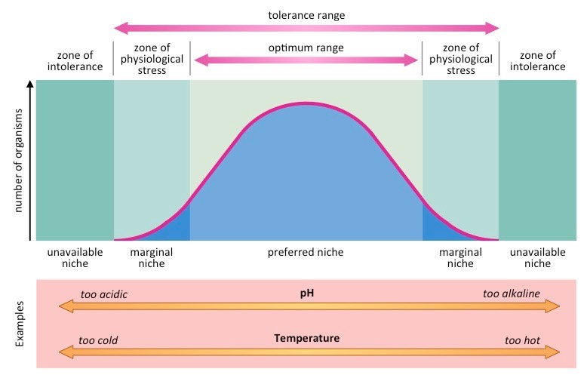
Tolerance ranges

Slide 10
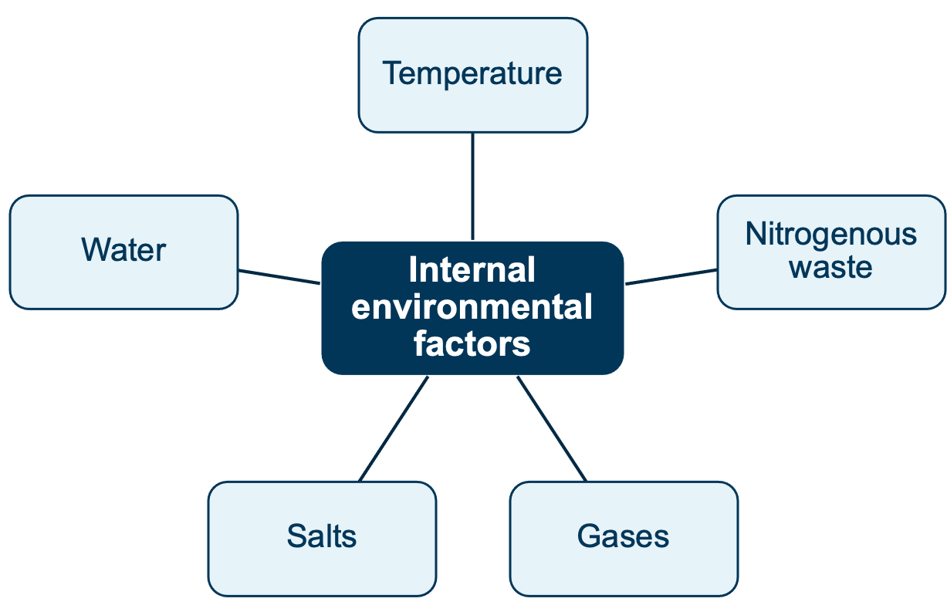
Topic Question 3: Give examples of internal environmental factors that organisms need to keep within a range

Slide 11
Topic Question 4: Using specific examples provide reasons why organisms need to keep environmental factors within narrow ranges
The concentration if glucose, carbon dioxide, hydrogen ions in cells, interstitial fluid and blood plasma all affect cell function
A by product of metabolism is carbon dioxide and heat
An increase in carbon dioxide in cells causes a decrease in pH

Slide 12
Topic Question 4: Using specific examples provide reasons why organisms need to keep environmental factors within narrow ranges
The activities of enzymes are affected by body temperature & pH
The movement of materials across membranes is affected by water concentration, nutrients and ions (salts - sodium & chloride) on either side of the membrane
Biochemical pathways (A linked series of chemical reactions in living organisms) can be disrupted and cells can be killed by small changes such as those listed above

Slide 13
Topic Question 5: State how organisms maintain homeostasis
Diseases, trauma, toxic substances and extremes in the internal and external environment can interfere with homeostasis
Responding to these changes and correcting them back to normal is essential so biochemical processes/pathways can be maintained. The process of how this is achieved by organisms is referred to as a feedback mechanism

Slide 14
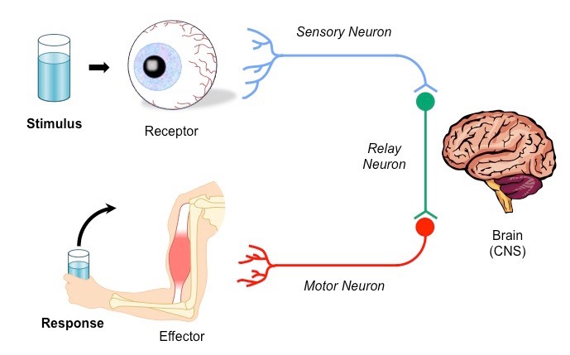
Topic Question 6: State the name of the model used to describe how organisms maintain homeostasis and the 2 stages of this model
Two stages of homeostatic regulation:
detection of a change from the stable state, known as the stimulus;
response to the stimulus, described as counteracting the change.
This is called the stimulus-response model

Slide 15
Topic Question 7: State the systems involved in maintain homeostasis

Slide 16
Topic Question 8: State how stimuli are detected in animals
There are millions of external and internal receptors that allow an organism to respond to stimuli.

Slide 17
Topic Question 9: State the different receptors of animals and the stimuli they detect
There are millions of external and internal receptors that allow an organism to respond to stimuli.
Type | Stimuli | Location in animals
Chemoreceptor | (Internal receptors) Detect oxygen and ion levels | Aorta, carotid arteries
Osmoreceptor | (Internal receptors) Detect changes in osmotic pressure in blood (changes in blood water concentration) | Hypothalamus
Photoreceptor | (External receptors) Light | Eyes; light-sensitive cells on body surface of some invertebrates
Thermoreceptor | (External receptors) Detect external temperature variations | Skin
 | (Internal receptors) Detect internal temperature variations | Hypothalamus

Slide 18
Topic Question 10: State how the nervous system maintains homeostasis
A stimulus is detected by a receptor and a message is sent to an effector via the nervous system or the endocrine system
Effectors are the muscles or glands that respond to the stimuli.
A message sent to a muscle involves the nervous system

Slide 19
Topic Question 11: State how the endocrine system maintains homeostasis
Not all changes in an organism’s internal and external environment require an immediate response. Some responses take time and are under the control of hormones produced by the endocrine system.
Endocrine gland | Hormone secreted | Target tissue/organ | Function related to homeostasis
Posterior pituitary | Antidiuretic hormone | Kidney | Stimulates reabsorption of water
Thyroid | Thyroxine | Nearly all tissues | Increases metabolic rate, and as a result increases oxygen consumption and production of heat
The nervous and endocrine systems work together during homeostasis. The
Nervous system executes a relatively fast response along neurons and the
endocrine system executes a relatively slow response.
Notes:
The nervous and endocrine systems work together during homeostasis. The
Nervous system executes a relatively fast response along neurons and the
endocrine system executes a relatively slow response.

Slide 20
Activities
Biology WA Units 3 & 4
Set 10.1 pg. 337 Q1, 3 & 7
Biozones
40 Maintaining Homeostasis
41 Detecting Change
44 Types of Cell Signalling
51 Hormonal Regulation
54 Nervous Regulatory Systems
64 The Homeostatic Role of Blood

Slide 21
Topic Question 12: Define negative & Positive feedback
Can be Positive or Negative
Mechanisms where the response counteracts the stimulus are referred to as a negative feedback
Almost all homeostatic control mechanisms are negative feedback mechanisms
In Positive Feedback Mechanisms the response enhances the original stimulus
Example: child birth. During labour, a hormone called oxytocin is released which intensifies & speeds up contractions. The increase in contractions causes more oxytocin to be released
https://www.youtube.com/watch?v=Iz0Q9nTZCw4&list=PLsMs3sjjy-pCcR8l3ohnIUhIiCwEjQB6K&index=60&t=13s

Slide 23
Topic Question 12: Define negative & Positive feedback
A negative feedback loop (or model) is a homeostatic process that changes the direction of a stimulus
The stimulus initially deviates away from normal.
A negative feedback loop will always reduce the stimulus.
Negative feedback can be modelled using a flow diagram.
The negative feedback model is represented as a cycle but, in reality, the mechanism is only cyclic if a stimulus continuously occurs after negative feedback.

Slide 24
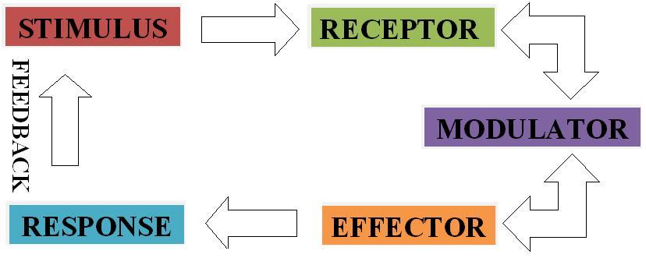

Slide 25
Topic Question 13: Name the parts of the negative feedback model and describe how each part works to maintain homeostasis
Part of model | What it is and what it does
Stimulus | A change in one of the internal or external environmental factors that is detected by a receptor. The change involves a deviation away from the normal/optimal value.
Receptor | The cell or tissue that detects the stimulus (change in the environment). The receptor may be internal or external.
Coordinating centre (modulator) | (Usually the hypothalamus) receives messages from receptors (via sensory neurons), coordinates a response, then sends an instruction to an effector via motor neurons.

Slide 26
Topic Question 13: Name the parts of the negative feedback model and describe how each part works to maintain homeostasis
Part of model | What it is and what it does
Effector | A muscle or gland that receives the message from the control centre and carries out the response
Response | The action of the effector that counteracts the stimulus (i.e. the change made by the effector)
Negative feedback | A message that counteracts the stimulus; it returns the value back to its normal/ optimal value

Slide 27
STIMULUS
Any change in the internal/external environment detected
Physical – light, heat, pressure
Chemical – hormone, neurotransmitters
RECEPTOR
Structure (cell or tissue) in the body which detects the stimuli
Chemoreceptors, thermoreceptors, osmoreceptors mechanoreceptors, photoreceptors
MODULATOR
Part of the brain which regulate the activity of the effector
FEEDBACK
A message that counteracts the stimulus; it returns the value back to its normal/ optimal value
RESPONSE
Action carried out by the effector to cancel/counteract the original stimuli & return to homeostasis
EFFECTOR
Structure of the body which carriers out the necessary response to maintain homeostasis

Slide 28
STIMULUS
Change in the environment that causes system to operate. (Above or below the normal).
RECEPTOR
Detects change
MODULATOR
Control centre responsible for processing information received from receptor & sending information to effector
Modulator processes this ‘information’
Stimulus detected by a receptor
Receptor sends message to the modulator
stimulus cancelled homeostasis is maintained
When the stimulus is above a threshold, modulator sends message to the effector
FEEDBACK
Achieved because original stimulus has been changed by the response
RESPONSE
Action and processes (mechanism) of the effector
EFFECTOR
Carries out response counteracting effect of stimulus
Effector receives message and carries out a response
Effector receives message and carries out a response

